Slide 1

Fall 2013
CSE 489: Digital Image Processing
Topic – 5: Image Restoration
Contents:
  Basics
  Low-Pass Filters
  Median Filters

Slide 2
Basics
Image restoration is a process or operation by which a degraded image is restored to its original condition.
The aim of image restoration is the removal of noise (sensor noise, motion blur, etc.) from images.
The simplest possible approach for noise removal is various types of filters such as low-pass filters or median filters.
More sophisticated methods assume a model of how the local image structures look like, a model which distinguishes them from the noise.
By first analyzing the image data in terms of the local image structures, such as lines or edges, and then controlling the filtering based on local information from the analysis step, a better level of noise removal is usually obtained compared to the simpler approaches.

Slide 3
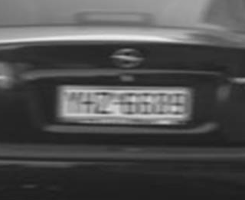
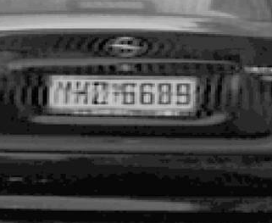
Basics
Image Restoration

Slide 4
Low-Pass Filters
Noise in an image usually appears as snow (white or black) randomly sprinkled over an image.
Spikes, or very sharp, narrow edges in the image cause snow. A low-pass filter smoothes and often removes these sharp edges.

Slide 5
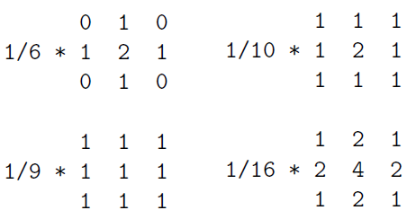
Low-Pass Filters
Low-pass filtering smoothes out sharp transitions in gray levels and removes noise.
Some low-pass filter convolution masks:

Slide 6
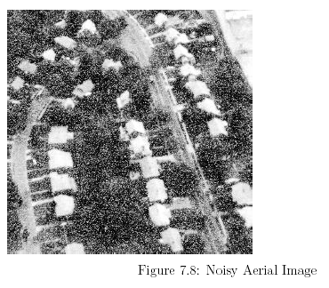
Low-Pass Filters

Slide 7
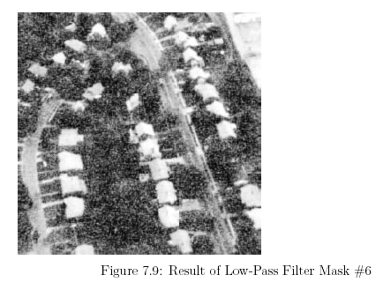
Low-Pass Filters

Slide 8
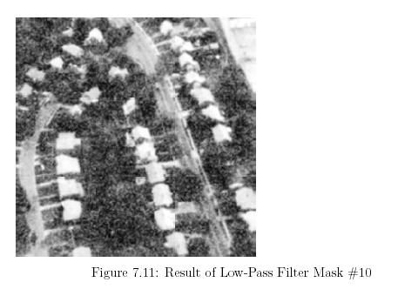
Low-Pass Filters

Slide 9
Median Filters
A special type of low-pass filter is the median filter. The median filter takes an area of an image (3x3, 5x5, 7x7, etc.), looks at all the pixel values in that area, and replaces the center pixel with the median value. The median filter does not require convolution. It does, however, require sorting the values in the image area to find the median value.

Slide 10
Median Filters
There are two noteworthy features of the median filter.
  It is easy to change the size of the median filter. (The images later will show the effect of using a different size.) Implementing the different size is a simple matter of changing for loops in the code.
  Median filters remove noise in images, but change noise-free parts of images minimally.

Slide 11
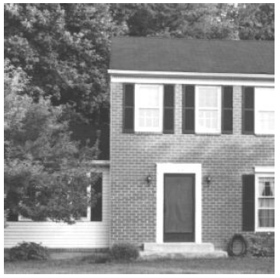
Filtering: Median Filters
House Image

Slide 12
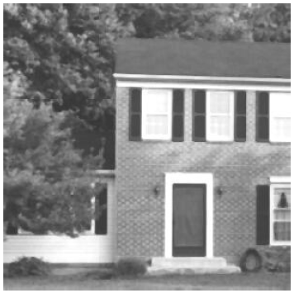
Filtering: Median Filters
Result of 3x3 Median Filter

Slide 13

Filtering: Median Filters
Result of 5x5 Median Filter

Slide 14

Filtering: Median Filters
Result of 7x7 Median Filter

